Slide 1

Warby Parker
Funnels Usage – SQL Project GIRISH KEMBA 08/28/2020

Slide 2
Table of Contents
Quiz Funnel
Home Try-On Funnel
Purchase Funnel
Most Common Styles

Slide 3
1. Quiz Funnel

Slide 4
1.1. What is the number of responses for each question?
1.2. Which question has a lower completion rate?
This question is targeted at demonstrating the number of responses each question has. Using the adjacent code, we’ll get the number of responses per question.
Using a spreadsheet program we get the completion rates from one question to another which answers the second question. We can see that
the third and the fifth questions have the lowest completion rates.
select question,
count(response) as 'no_of_responses'
from survey
group by question;
Question | Number of Responses | Completion Rate
1. What are you looking for? | 500 | 100%
2. What's your fit? | 475 | 95%
3. Which shapes do you like? | 380 | 80%
4. Which colors do you like? | 361 | 95%
5. When was your last eye exam? | 270 | 75%

Slide 5
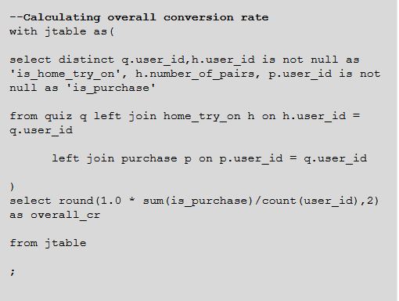

1.3. Quiz responses and questions completion rates
●Quiz questions showed top least completions where for Q5 (74.8%) and Q3 (80.0%) respectively
●Overall conversion rate at 49%

Slide 6
2. Home Try-On Funnel

Slide 7

2.1 Examine the first five rows of each table What are the column names?
with conversion_table as
(
select distinct q.user_id,
h.user_id is not null as 'is_home_try_on',
h.number_of_pairs,
p.user_id is not null as 'is_purchase'
from quiz as 'q'
left join home_try_on as 'h'
on h.user_id = q.user_id
left join purchase as 'p'
on p.user_id = q.user_id
)
select number_of_pairs,
round(100.0*sum(is_purchase)/count(user_id),2)as 'overall_cr'
from conversion_table
where number_of_pairs is not null
group by number_of_pairs;
Warby Parker’s purchase funnel is:
Style Quiz → Home Try-On →Purchase the Perfect Pair of Glasses.
During the Home Try-On stage, we will be conducting an A/B Test:
50% of the users will get 3 pairs to try on
50% of the users will get 5 pairs to try on

Slide 8
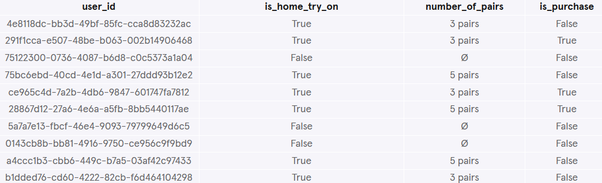
2.2 Use a LEFT JOIN to combine the three tables, starting with the top of the funnel (quiz) and ending with the bottom of the funnel (purchase).
Select q.user_id,
case
when h.user_id is not null then 'True'
else 'False'
End as 'is_home_try_on',
h.number_of_pairs,
case
when p.user_id is not null then 'True'
else 'False'
end as 'is_purchase'
from quiz as 'q'
left join home_try_on as 'h'
on h.user_id = q.user_id
left join purchase as 'p'
on p.user_id = h.user_id
limit 10;
Each row will represent a single user from the browse table:
If the user has any entries in home_try_on, then is_home_try_on
will be True.
number_of_pairs comes from home_try_on table
If the user has any entries in purchase, then is_purchase will be True.

Slide 9
3. Purchase Funnel

Slide 10
3.1. Warby Parker’s purchase funnel is:
Take the Style Quiz → Home Try-On → Purchase the Perfect Pair of
Glasses.
Using the adjacent code, we’ll get the numbers of customers who took the quiz, the number who took the home trial and the number who made the purchase.
WITH funnel AS (SELECT q.user_id AS 'quiz', h.address IS NOT NULL AS 'is_home_try_on', h.number_of_pairs,
p.product_id IS NOT NULL AS 'is_purchase' FROM quiz AS q
LEFT JOIN home_try_on AS h ON q.user_id = h.user_id LEFT JOIN purchase AS p ON h.user_id = p.user_id
SELECT COUNT(quiz) AS 'quiz_num', SUM(is_home_try_on) AS 'home_try_num', SUM(is_purchase) AS 'purchase_num'
FROM funnel;
)
quiz_num | home_try_num | purchase_num
1000 | 750 | 495

Slide 11
3.2. Let’s compare the conversion from quiz → home_try_on
and home_try_on → purchase:
Using the adjacent code, we’ll get the conversion from quiz →
home_try_on and home_try_on → purchase.
WITH funnel AS (SELECT q.user_id AS 'quiz', h.address IS NOT NULL AS 'is_home_try_on', h.number_of_pairs,
p.product_id IS NOT NULL AS 'is_purchase' FROM quiz AS q
LEFT JOIN home_try_on AS h ON q.user_id = h.user_id LEFT JOIN purchase AS p ON h.user_id = p.user_id
SELECT 1.0*SUM(is_home_try_on)/COUNT(quiz) AS 'try_on_conv',
1.0*SUM(is_purchase)/SUM(is_home_try_on)
AS 'purchase_conv'
FROM funnel;
try_on_conv | purchase_conv
0.75 | 0.66
)
We can see that the number of customers who make a purchase are 66% of those who reach the Home Try-on Stage. And 75% of the customers who take the style quiz, go on to the Home Try-on Stage.
Now, let’s see the result of our A/B test. We want to find out whether or not users who get more pairs to try on at home will be more likely to make a purchase.

Slide 12
3.3. Let’s compare the purchase rates between customers who
had 3 number_of_pairs with ones who had 5:
Using the adjacent code, we’ll get the conversion from quiz →
home_try_on and home_try_on → purchase.
WITH funnel AS (SELECT q.user_id AS 'quiz', h.address IS NOT NULL AS 'is_home_try_on', h.number_of_pairs AS 'number_of_pairs', p.product_id IS NOT NULL AS 'is_purchase'
FROM quiz AS q
LEFT JOIN home_try_on AS h ON q.user_id = h.user_id LEFT JOIN purchase AS p ON h.user_id = p.user_id
SELECT number_of_pairs, ROUND(1.0*SUM(is_purchase)/SUM(is_home_try_on),2)
AS 'purchase_conv'
FROM funnel
WHERE number_of_pairs IS NOT NULL GROUP BY number_of_pairs;
number_of_pairs | purchase_conv
3 pairs | 0.53
5 pairs | 0.79
)
We can see that the purchase rate for the customers who had 3
pairs is significantly less than those who had 5 pairs to try on.
We can conclude that the number of pairs customers get to try on can affect their decision about whether or not to make a purchase.

Slide 13
4. Most Common Styles

Slide 14
4.1. Most common styles people are interested in while
answering the survey:
Using the adjacent code, we’ll get the most common styles people
are interested in while answering the survey.
SELECT style,
COUNT(user_id) FROM quiz
GROUP BY 1 ORDER BY 2 DESC;
style | COUNT(user_id)
Women's Styles | 469
Men's Styles | 432
I'm not sure. Let's skip it. | 99
We can see that the women’s styles are more common than the
men’s within the survey results.

Slide 15
4.2. Most common styles people actually purchase:
Using the adjacent code, we’ll get the most common styles people
actually purchase.
SELECT style, COUNT(user_id) FROM purchase
GROUP BY 1 ORDER BY 2 DESC;
style | COUNT(user_id)
Women's Styles | 252
Men's Styles | 243
We can conclude that women’s styles are more common both when
it comes to surveys and actual purchases.

Slide 16
Thank you!

